Slide 1
Emergency Badge
2nd Charleville Lone Girl Guides

Slide 2
Our Girl Guide Promise
I promise that I will do my best
To be true to myself and develop my beliefs
To serve my community and Australia
And live by the Guide Law

Slide 3
If there is a fire in your house, what should you do?
Notes:
Use the annotation tool to have girls write on the screen or just discuss what you should do

Slide 4
What could you and your family do to prepare yourself in case of a house fire?
Notes:
Use the annotation tool to have girls write on the screen or just discuss what you should do

Slide 5
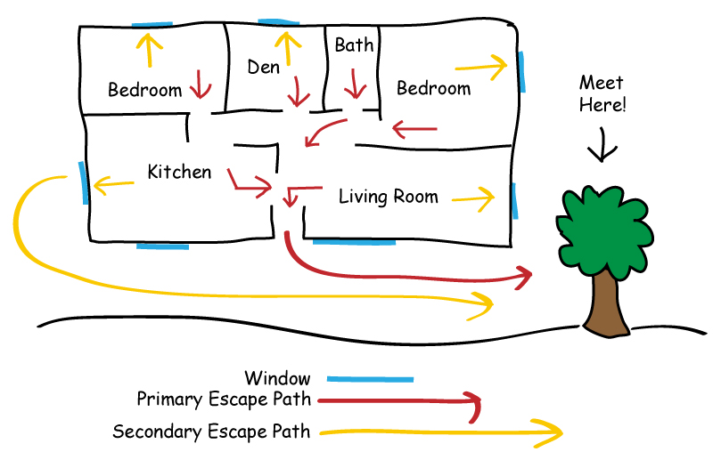
How to make a Home Fire Escape Plan
Draw a map of your house. Show all doors and windows.
Pick a meeting place outside. It should be in front of your home. Everyone will meet at the meeting place.
Window
Primary escape path
Secondary escape path
Fire extinguisher
Water source
Assembly point
Notes:
Have Guides make their Fire Escape Plan on paper

Slide 6
Reflection: what was the most fun today?
Notes:
Use the annotation tool to have girls write on the screen

